Slide 1





GLA UNIVERSITY
COMPUTER NETWORK

Slide 2

TRANSMISSION MEDIA

Slide 3
Media
Basic function of media
  carry flow of information in form of bits
  In a copper based network, bits will be electrical signals
  In a fiber based network, bits will be light pulses

Slide 4
Transmission Media
Physical path between transmitter and receiver
Wired and Wireless
Communication is in the form of electromagnetic waves
Characteristics and quality of data transmission are determined by characteristics of medium and signal
In wired media, medium characteristics is more important, whereas in wireless media, signal characteristics is more important

Slide 5
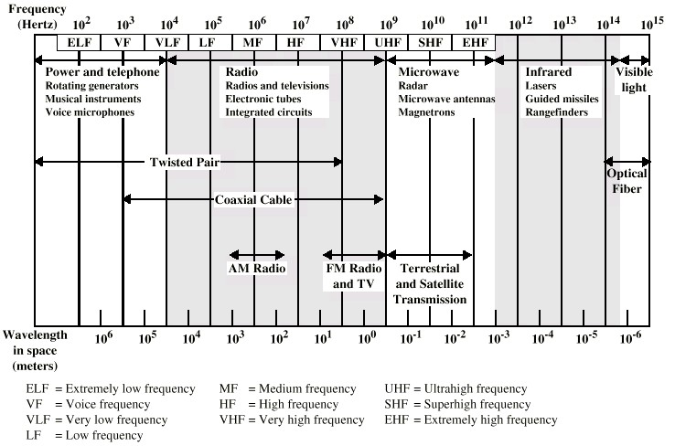
Electromagnetic Spectrum

Slide 6
Basic limitations
Attenuation
Delay Distortion
Noise
  Thermal/White Noise
  Intermodulation Noise
  Crosstalk
  Echo
  Impulse Noise

Slide 7
Design Factors for Transmission Media
Bandwidth: All other factors remaining constant, the greater the band-width of a signal, the higher the data rate that can be achieved.
Transmission impairments: Limit the distance a signal can travel.
Interference: Competing signals in overlapping frequency bands can distort or wipe out a signal.
Number of receivers: Each attachment introduces some attenuation and distortion, limiting distance and/or data rate.

Slide 8
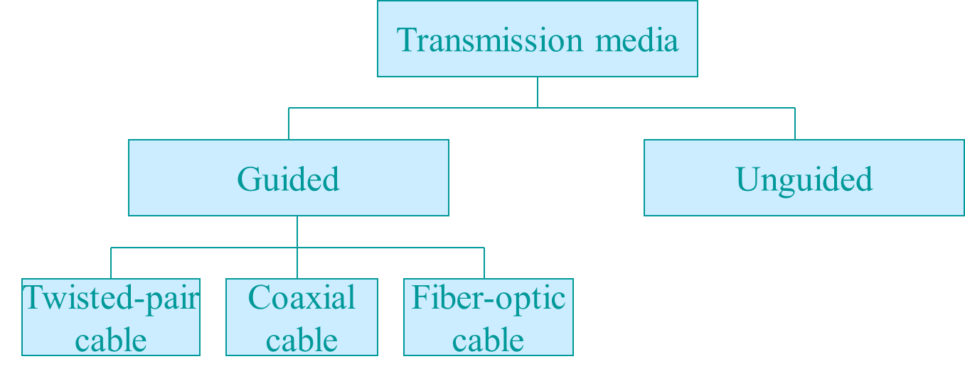
Classes of Transmission Media
Conducted or guided media
  use a conductor such as a wire or a fiber optic cable to move the signal from sender to receiver
Wireless or unguided media
  use radio waves of different frequencies and do not need a wire or cable conductor to transmit signals

Slide 9
Wire Conductors
Wire types: single
conductor, twisted pair, & shielded
multiconductor bundles
Large installed base
Reasonable cost
Relatively low bandwidth, however, recent LAN speeds in the 100
Mbps range have been achieved
Susceptible to external interference
Shielding can reduce external interference
Can transmit both analog and digital signals. Amplifier required every 5 to 6 km for analog signals. For digital signals, repeaters required every 2 to 3 km

Slide 10
Wired - Twisted Pair
The oldest, least expensive, and most commonly used media
Pair of insulated wires twisted together to reduce susceptibility to interference : ex) capacitive coupling, crosstalk
Skin effect at high frequency
Up to 250 kHz analog and few Mbps digital signaling ( for long- distance point-to-point signaling)
Need repeater every 2-3 km (digital), and amplifier every 5-6 km (analog)

Slide 11
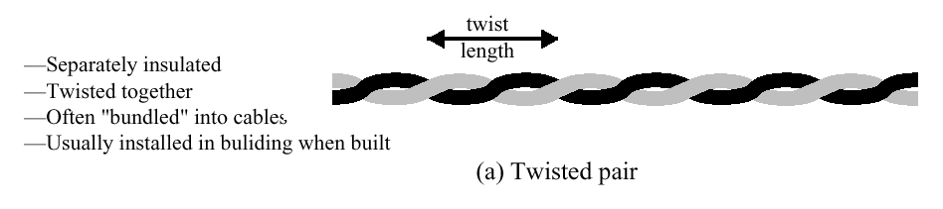
Twisted Pair
Consists of two insulated copper wires arranged in a regular spiral pattern to minimize the electromagnetic interference between adjacent pairs
Often used at customer facilities and also over distances to carry
voice as well as data communications
Low frequency transmission medium
Telephone (subscriber loop: between house and local exchange)
High-speed (10 - 100 Mbps) LAN
– token ring, fast - Ethernet
:

Slide 12
Types of Twisted Pair
STP (shielded twisted pair)
  the pair is wrapped with metallic foil or braid to insulate the pair from electromagnetic interference
UTP (unshielded twisted pair)
  each wire is insulated with plastic wrap, but the pair is encased in an outer covering

Slide 13
Ratings of Twisted Pair
Category 3
– UTP cables and associated connecting hardware whose transmission characteristics are
specified up to 16 MHZ.
– data rates of up to 16mbps are achievable
Category 4
– UTP cables and associated connecting hardware whose transmission
characteristics are specified up to 20 MHz.
Category 5
– UTP cables and associated connecting hardware whose transmission
characteristics are specified up to 100 MHz.
data rates of up to 100mbps are achievable
more tightly twisted than Category 3 cables
more expensive, but better performance
Category 5 enhanced, Cat 6, cat 7
  Fast and giga-ethernet
STP
  More expensive, harder to work with

Slide 14
Twisted Pair Advantages
Advantages
  Inexpensive and readily available
  Flexible and light weight
  Easy to work with and install
Disvantages
  Susceptibility to interference and noise
  Attenuation problem
    For analog, repeaters needed every 5-6km
    For digital, repeaters needed every 2-3km
  Relatively low bandwidth (MHz)

Slide 15
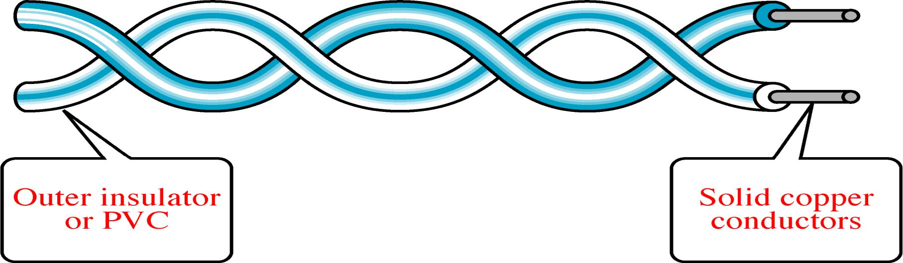
Twisted-Pair Cable

Slide 16
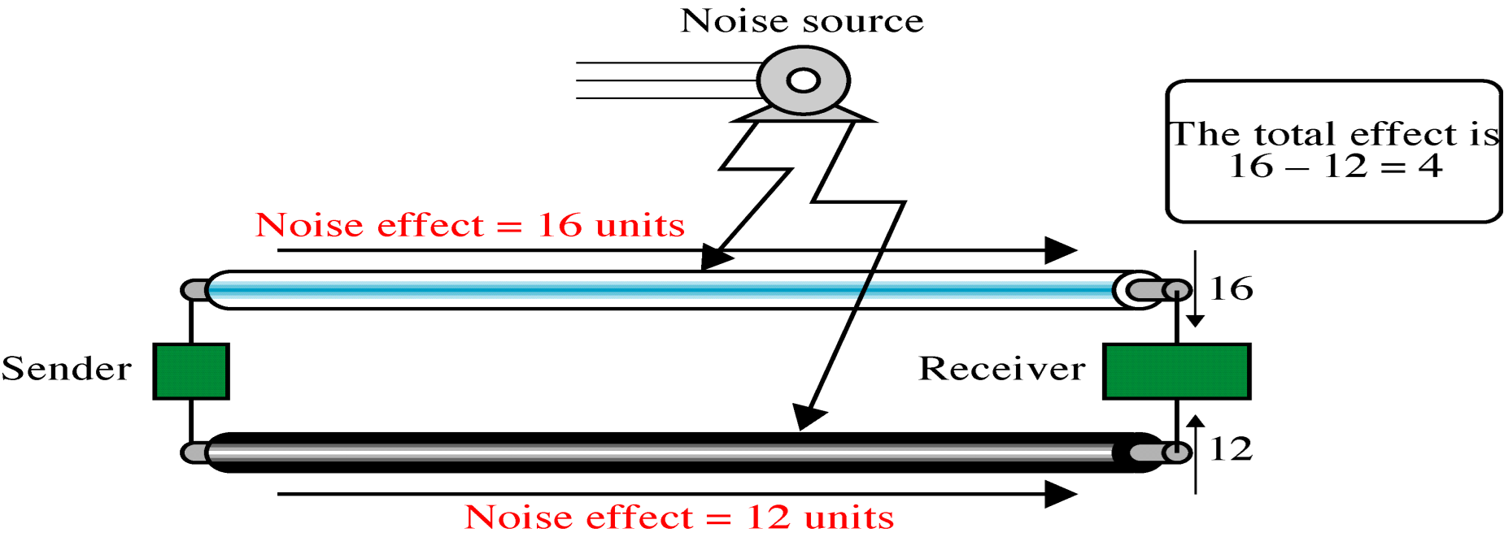
Effect of Noise on Parallel Lines

Slide 17
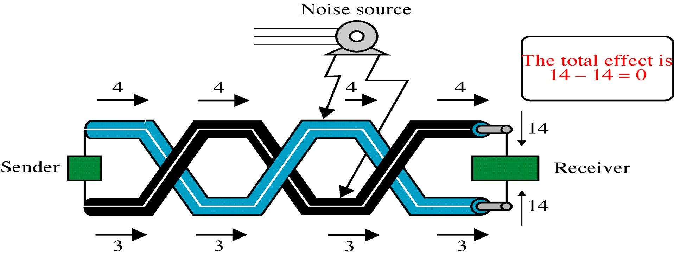
Noise on Twisted-Pair Lines

Slide 18
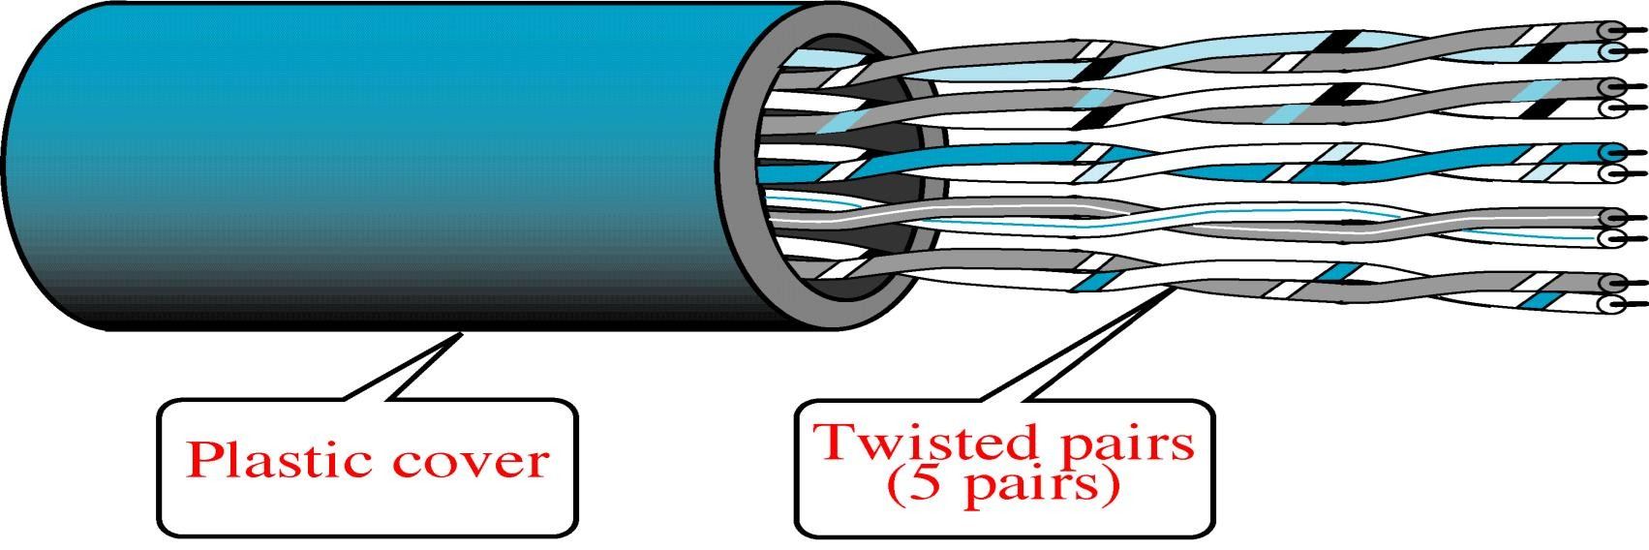
Unshielded Twisted-Pair Cable

Slide 19
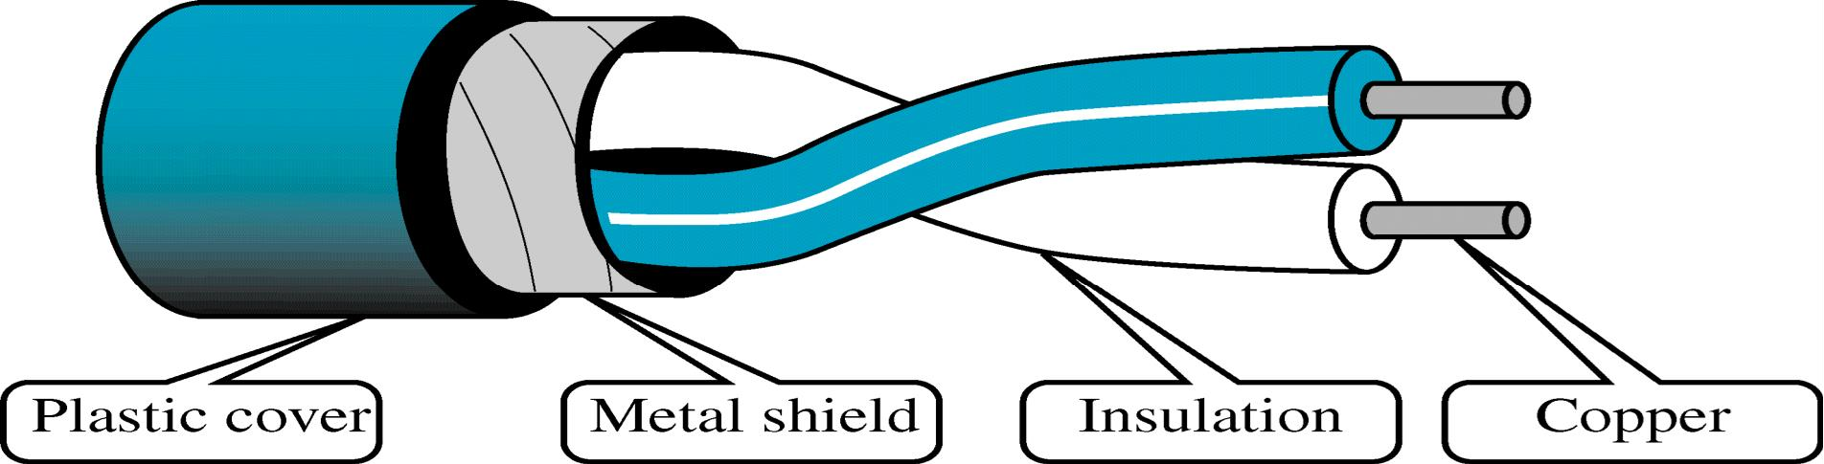
Shielded Twisted-Pair Cable

Slide 20
Wired Transmission Media
Coaxial Cable
  Most versatile medium
    LANs, Cable TV, Long-distance telephones, VCR-to-TV connections
  Noise immunity is good
  Very high channel capacity
    few 100 MHz / few 100 Mbps
  Need repeater/amplifier every few kilometer or so (about the same as with twisted pair)
Has an inner conductor surrounded by a braided mesh
Both conductors share a common center axial, hence the term “co- axial”

Slide 21
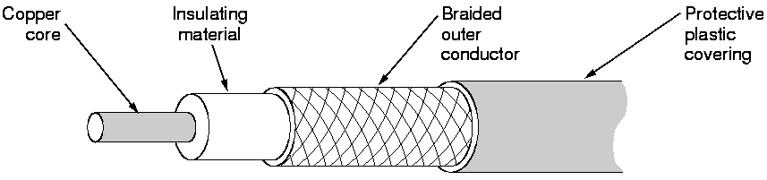
Coaxial cable
Signal and ground wire
  Solid center conductor running coaxially inside a solid (usually braided) outer circular conductor.
  Center conductor is shielded from external interference signals.

Slide 22
Properties of coaxial cable
Better shielding allows for longer cables and higher transfer rates.
100 m cables
  1 to 2 Gbps feasible (modulation used)
  10 Mbps typical
Higher bandwidth
– 400 to 600Mhz
  up to 10,800 voice conversations
Can be tapped easily: stations easily added (pros and cons)
Much less susceptible to interference than twisted pair
Used for long haul routes by Phone Co.
  Mostly replaced now by optical fiber.
High attenuation rate makes it expensive over long distance
Bulky
Baseband vs. broadband coax.

Slide 23
Wired Transmission Media
Optical Fiber
  Flexible, thin (few to few hundred μm), very pure glass/plastic fiber capable of conducting optical rays
  Extremely high bandwidth : capable of ≥ 2 Gbps
  Very high noise immunity, resistant to electromagnetic interference
  Does not radiate energy/cause interference
  Very light
  Need repeaters only 10’s or 100 km apart
  Very difficult to tap : Better security but multipoint not easy
  Require a light source with injection laser diode (ILD) or light- emitting diodes (LED)

Slide 24
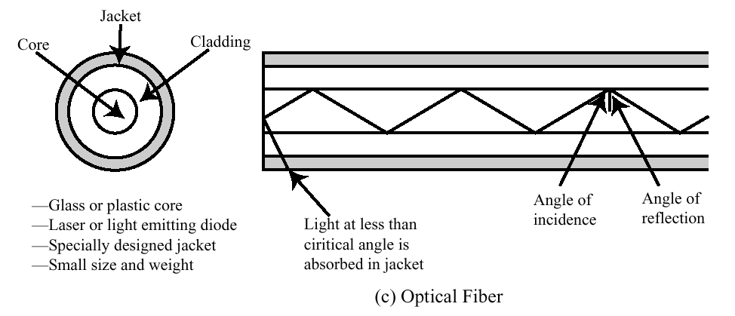
Wired Transmission Media
Need optical-electrical interface (more expensive than electrical
interface)

Slide 25
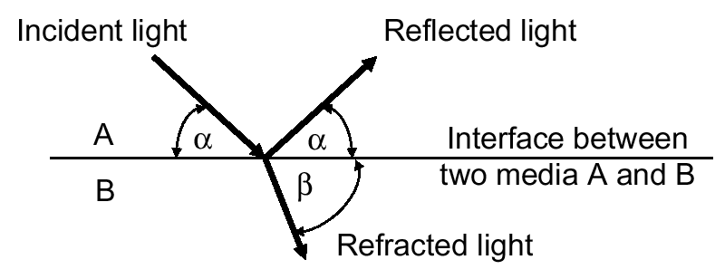
Wired Transmission Media
Principle of optical fiber transmission: Based on the principle of total internal
reflection
If β>α, medium B (water) has a higher optical density than medium A (air)
In case the index of refraction<1 (α>β), if α is less than a certain critical angle, there is no refracted light i.e., all the light is reflected. This is what makes fiber optics work

Slide 26
Fiber optics & Physics 101
Refractive
^{index}material
=
(Speed of light in vacuum)/(Speed of light in material)
Light is bent as it passes through a surface where the refractive index changes. This bending depends on the angle and refractive index. Frequency does not change, but because it slows down, the wave length gets shorter, causing wave to bend.
In case of fiber optic media, refractive index of core > refractive index of cladding thereby causing internal reflection.
cladding
core

Slide 27

Fiber Optic Layers
consists of three concentric sections
plastic jacket
glass or plastic cladding
fiber core

Slide 28
Modes of fiber
Fiber consists of two parts: the glass core and glass cladding with a
lower refractive index.
Light propagates in 1 of 3 ways depending on the type and width of the core material.
  Multimode stepped index fiber
    Both core and cladding have different but uniform refractive index.
    Relies on total internal reflection; Wide pulse width.
  Multimode graded index fiber
    Core has variable refractive index (light bends as it moves away from core).
    Narrow pulse width resulting in higher bit rate.
  Singlemode fiber (> 100 Mbs)
    Width of core diameter equal to a single wavelenth.

Slide 29
Mode
Multimode
Single mode
Step index
Graded-index

Slide 30
Fiber Optic Types
multimode step-index fiber
  the reflective walls of the fiber move the light pulses to the receiver
multimode graded-index fiber
  acts to refract the light toward the center of the fiber by variations in the density
single mode fiber
  the light is guided down the center of an extremely narrow core

Slide 31
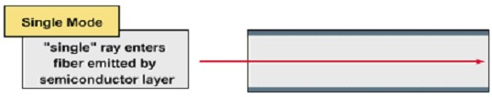
Types of optical fiber
Modes, bundles of light rays enter the fiber at a particular angle
Single-mode
  Also known as mono-mode
  Only one mode propagates through fiber
  Higher bandwidth than multi-mode
  Longer cable runs than multi-mode
  Lasers generate light signals
  Used for inter-building connectivity

Slide 32

Types of optical fiber
Multi-mode
  Multiple modes propagate through fiber
  Different angles mean different distances to travel
    Transmissions arrive at different times
    Modal dispersion
  LEDs as light source
  Used for intra-building connectivity

Slide 33
Fiber Optic Signals
fiber optic multimode step-index
fiber optic multimode graded-index
fiber optic single mode

Slide 34
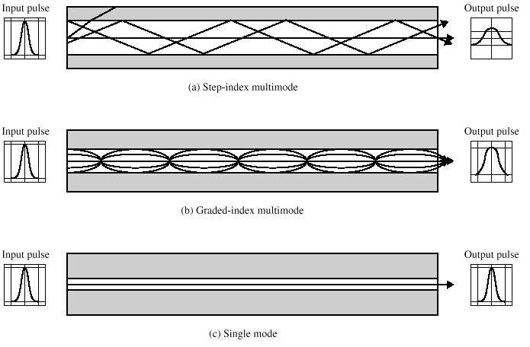
Optical Fiber Transmission Mode

Slide 35
Fiber Optic
Advantages
greater capacity (bandwidth Gbps)
smaller size and lighter weight
lower attenuation
immunity to environmental interference
highly secure due to tap difficulty and lack of signal radiation Disvantages
expensive over short distance
requires highly skilled installers
adding additional nodes is difficult

Slide 36
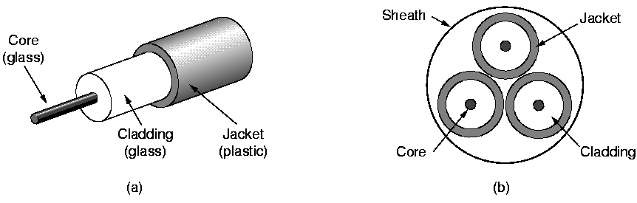
Fiber cables
Multimode: diameter of core is ~50 microns
– About the same as a human hair
Single mode: diameter of core 8-10 microns
They can be connected by connectors, or by splicing, or by fusion

Slide 37
Fiber vs. copper
Fiber (pros)
  Higher bandwidth,
  Lower attenuation,
  Immune to electromagnetic noise and corrosive chemicals,
  Thin and lightweight,
  Security (does not leak light, difficult to tap).
Fiber (cons)
  Not many skilled “fiber engineers,”
  Inherently unidirectional,
  Fiber interfaces are expensive.

